Slide 1
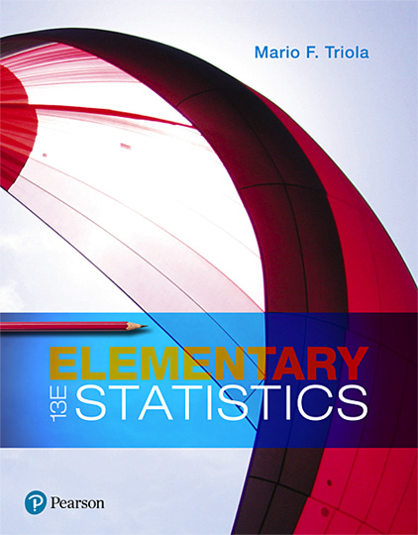
Elementary Statistics
Thirteenth Edition
Chapter 4
Probability
Copyright © 2018, 2014, 2012 Pearson Education, Inc. All Rights Reserved

Slide 2
Probability
4-1 Basic Concepts of Probability
4-2 Addition Rule and Multiplication Rule
4-3 Complements and Conditional Probability, and Bayes’ Theorem
4-4 Counting
4-5 Probabilities Through Simulations (available at TriolaStats.com)

Slide 3
Probabilities Through Simulations
The website Triola Stats includes a downloadable section that discusses the use of simulation methods for finding probabilities. Simulations are also discussed in the Technology Project near the end of this chapter.

